Slide 1
Testing the hardware components
By
Ajay kumar vattikonda(c0763572)
Group1

Slide 2
Contents
Testing device
Components that are to be tested
Other components required to test
References

Slide 3
Components that are to be tested
Arduino uno
Rain detection sensor module
Uv index sensor module
16*2 lcd display
Gsm module sim900
Dht11 sensor
Beaglebone black wireless
References

Slide 4
Testing device used
Arduino uno is used to test the components as it is the easier option.

Slide 5
Software of Arduino
In Arduino programming there are two main functions. Main functions are setup() and loop(). Setup()function is only operated once when device is booted up, it is mostly used to setup initiation settings.
Loop() is ran after the setup() function has finished, loop() function will run repeatedly until power off.

Slide 6
Software of arduino
Arduino programming is supported by wide amount of libraries.Large amount of open-source libraries are available from Arduino community. Libraries give access to live sensor data with single function.
After the user has written his code, IDE compile and translates the code to the assembler language. After translating the code, the IDE uploads the program to the Arduino microcontroller.

Slide 7
Software of arduino
IDE software includes the set of different kind of programs that are ready to be tested on the device. After testing the program it can be uploaded to the Arduino by USB cable that vary in different models

Slide 8
Testing of arduino uno
The simplest thing you can do with an Arduino to see physical output is: it blinks the on-board LED.This LED is connected to a digital pin and its number may vary from board type to board type.
Hardware requirements:
Arduino uno
Usb cable
Host machine

Slide 9
Arduino uno testing example
After you build the circuit plug your Arduino board into your computer, start the Arduino Software (IDE) and enter the code.
Then in ide software in the examples one can see the blink code already available and can run it
After compiling the program the onboard led will be on for 1 sec and turns of 1 sec and continues

Slide 10
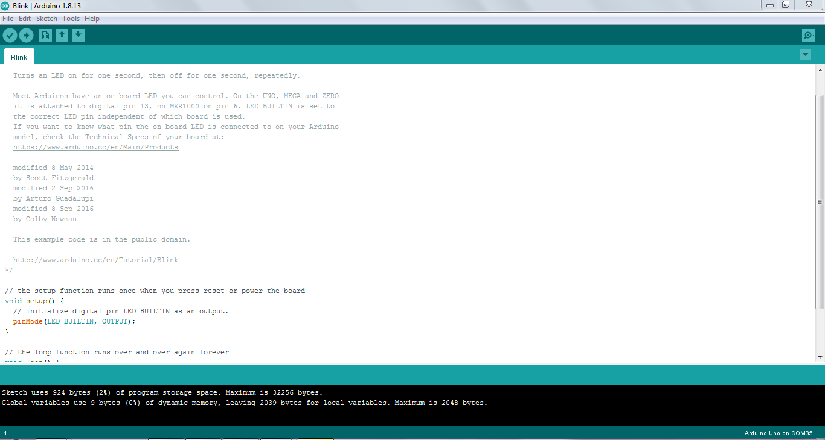
Arduino ide code for blinking onboard led

Slide 11
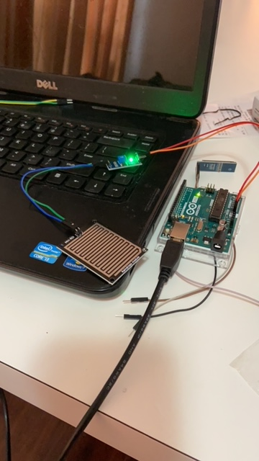
Testing the rain module sensor

Slide 12
Rain module sensor testing
Hardware requirements
Rain Sensor (model with an analog out)
3x Male to Female jumper wires
2x Female to Female jumper wires
An Arduino
Source of water

Slide 13
Rain water sensor module testing
Wire the Rain Sensor to the Arduino for analog output.
A0.......... Analog output
D0......... Digital output
GND..... Ground
VCC...... Positive voltage (input: 5v for analog 3.3v for Digital.)

Slide 14
Rain water sensor module testing
To test the Rain Sensor connect the VCC to a 5v power source and GND. Put a few drops of water on sensor board and D0-LED should light up.
If the Sensor Board is dry; " Not Raining " will be sent to the serial monitor.
If the Sensor Board is completely soaked; " Flood " will be sent to the serial monitor.
If the Sensor Board has water droplets on it; " Rain Warning " will be sent to the serial

Slide 15
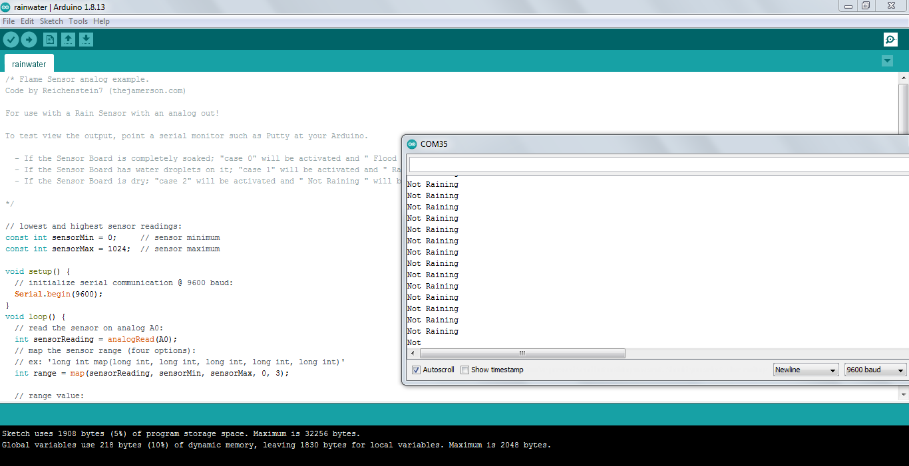
Arduino uno code

Slide 16
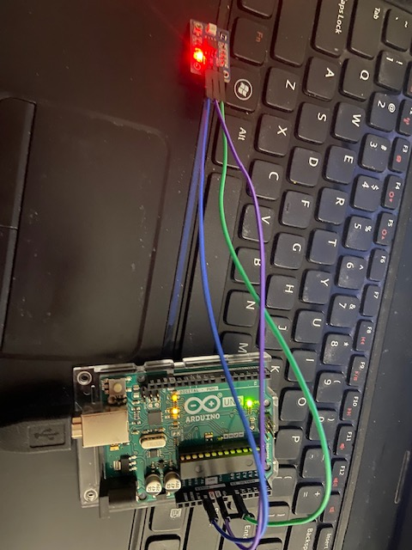
Uv sensor module testing

Slide 17
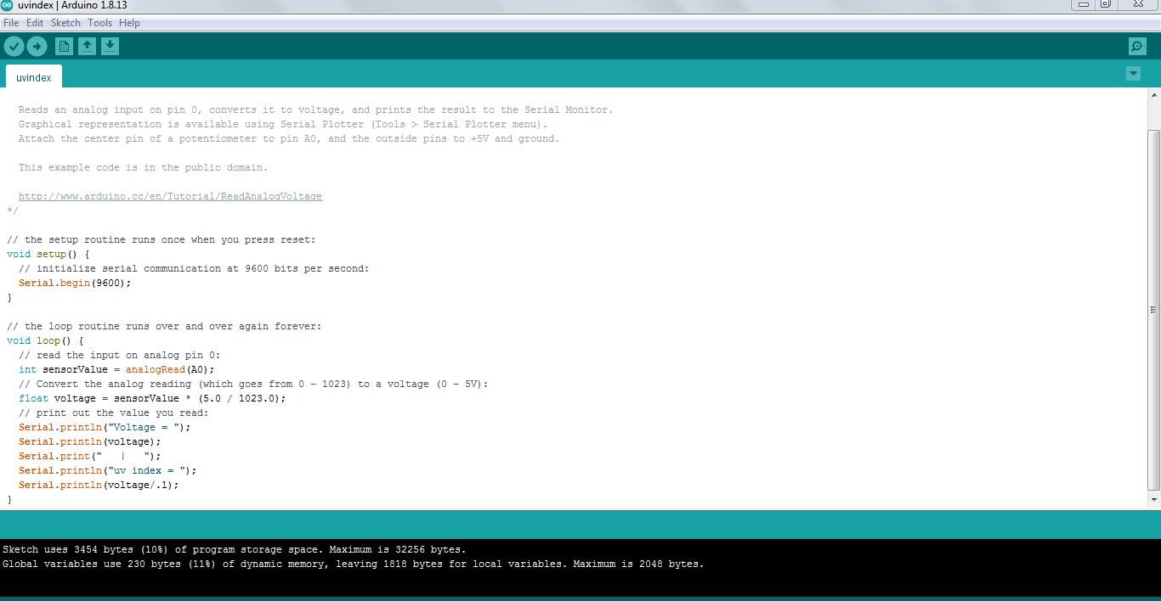
Uv sensor module testing

Slide 18
Uv sensor module specifications
Analog UV Light Sensor Breakout - GUVA-S12SD Extend your light-sensing spectrum with this analog UV sensor module. It uses a UV photodiode, which can detect the 240-370nm range of light (which covers UVB and most of UVA spectrum).
The signal level from the photodiode is very small, in the nano-ampere level, so we tossed on an Op Amp to amplify the signal to a more manageable volt-level. This sensor is much simpler than our Si1145 breakout, for it only does one thing and gives an analog voltage output instead of requiring a complicated I2C setup procedure.

Slide 19
Uv sensor module specfications
This makes it better for simple projects. It also has a 'true' UV sensor instead of a calibrated light-sensor. How to Use Power the sensor and op-amp by connecting V+ to 2.7-5.5VDC and GND to power ground.
Then read the analog signal from the OUT pin. The output voltage is: Vo = 4.3 (*Diode-Current-in-uA.) So if the photocurrent is 1uA (9 mW/cm²), the output voltage is 4.3V. You can also convert the voltage to UV Index by dividing the output voltage by 0.1V. So if the output voltage is 0.5V, the UV Index is about 5.

Slide 20
Uv sensor module testing
Wire the VIN pin of the UV Sensor to the (3v3) on the Arduino.
Wire the GND pin of the UV Sensor to the (GND) on the Arduino.
Wire the Analog output pin of the uv index sensor to A0 pin in the arduino

Slide 21
Uv sensor module testing
After wiring the uv sensor module go to the ide and downlaod the analog voltage example code
As the sensor gives the output in volatge as per the sensor specifications when we divide it by 0.1 it gives the uv index which is done

Slide 22
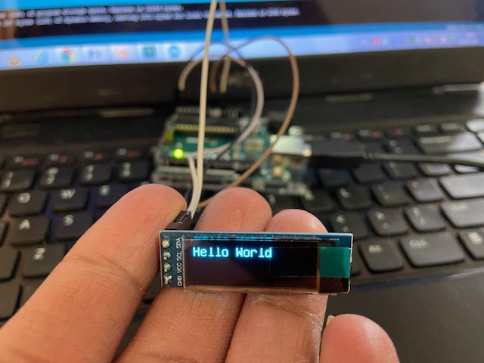
16*2 lcd module testing

Slide 23
Pin connections
OLED GND – Arduino GND
OLED VCC – Arduino 5V
OLED SCL – Arduino Uno A5
OLED SDA – Arduino Uno A4

Slide 24
Lcd display module testing
16×2 lcd display
Arduino Board
Jumper Wires
SOFTWARE
Arduino IDE (version 1.6.4+)
Arduino Library U8glib.h

Slide 25
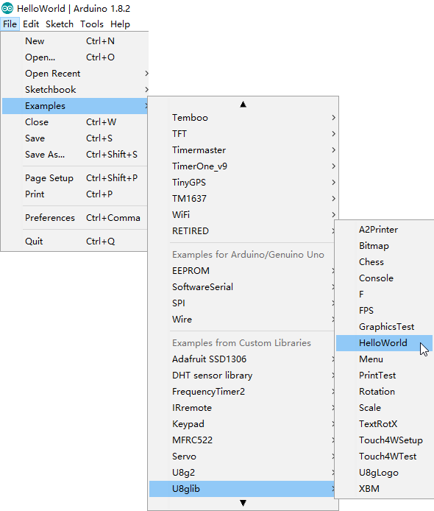
continution

Slide 26
continution
In ‘setup’ we first select the font we want to use.
After selecting the font, we establish that drawing something means that we want to turn a pixel on,using
‘u8g.setColorIndex(1)‘.
The void draw function is the most important part. This The function uses the u8g.drawBitmapP function from the U8 graphics library to draw the specified bitmap.

Slide 27
continution
The u8g.drawBitmapP function has five arguments; the first two are the x and y coordinates of the top left position on the screen where we want the graphics display to start from.
The 3rd argument is the width of the bitmap image (128 in this case) divided by 8 while the 4th argument is the height of the bitmap image (64 in this case).
The last argument is the variable name given to the byte array which represents the image to be displayed.

Slide 28
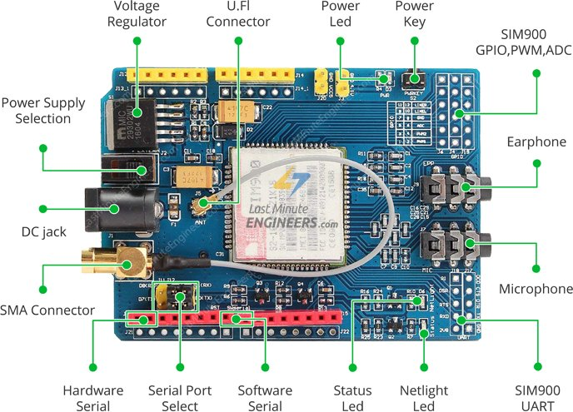
Gsm module testing

Slide 29
Gsm module
SIM900 GSM/GPRS shield is a GSM modem, which can be integrated into a great number of IoT projects. You can use this shield to accomplish almost anything a normal cell phone can; SMS text messages, Make or receive phone calls, connecting to internet through GPRS, TCP/IP, and more

Slide 30
Gsm module testing
Components required
Gsm module
Power adapter
Full sim card which is activated
Another mobile for calling to gsm sim

Slide 31
Gsm module led
There are three LEDs on the SIM900 GSM/GPRS shield which indicates connectivity or power status. By observing these LEDs you can get a visual feedback on whats going on with the shield.

Slide 32
continued
PWR: This LED is connected to the shield’s power supply line. If this LED is on, the shield is receiving power.
Status: This LED indicates SIM900’s working status. If this LED is on, the chip is in working mode.
Netlight: This LED indicates the status of your cellular network. It’ll blink at various rates to show what state it’s in.
off: The SIM900 chip is not running
64ms on, 800ms off: The SIM900 chip is running but not registered to the cellular network yet.
64ms on, 3 seconds off: The SIM900 chip is registered to the cellular network & can send/receive voice and SMS.
64ms on, 300ms off: The GPRS data connection you requested is active.

Slide 33
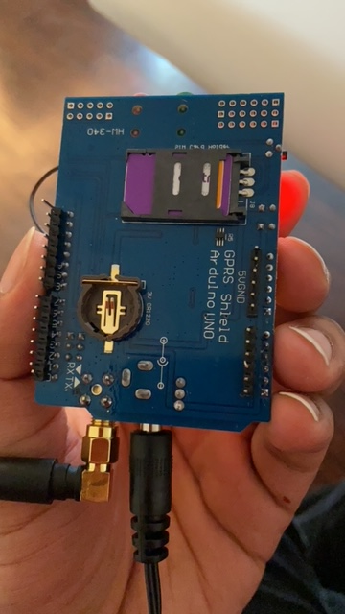
Gsm module testing
Here in this gsm module I placed the chatr network sim in the tray and powered it up with the adapter

Slide 34
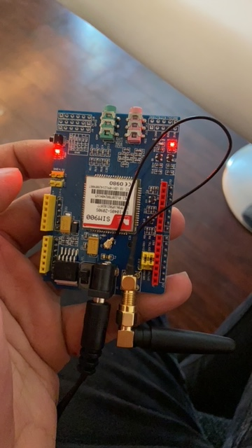
continued
After powering on the module the pwr led is on and the status led will be also on as you can see in picture

Slide 35
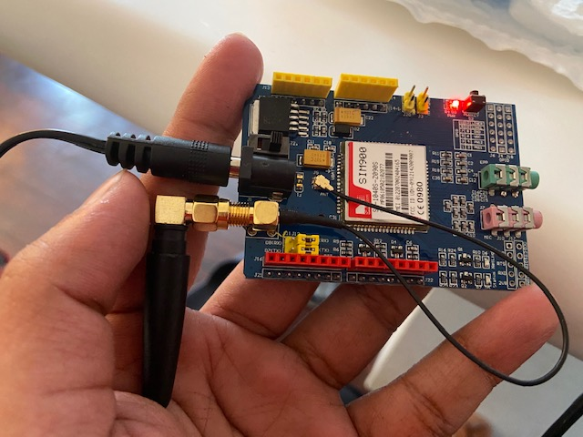
continued
When I make a call to the gsm sim from another mobile the status led will be off as you can see from picture

Slide 36
Digital multimeter
A digital multimeter is a testing device which is used to test the volatge or current flowing in the circuit
Here to test the digital multimeter I used a battery of 1.5v
After testing with the battery it displayed 1.59 v in display

Slide 37
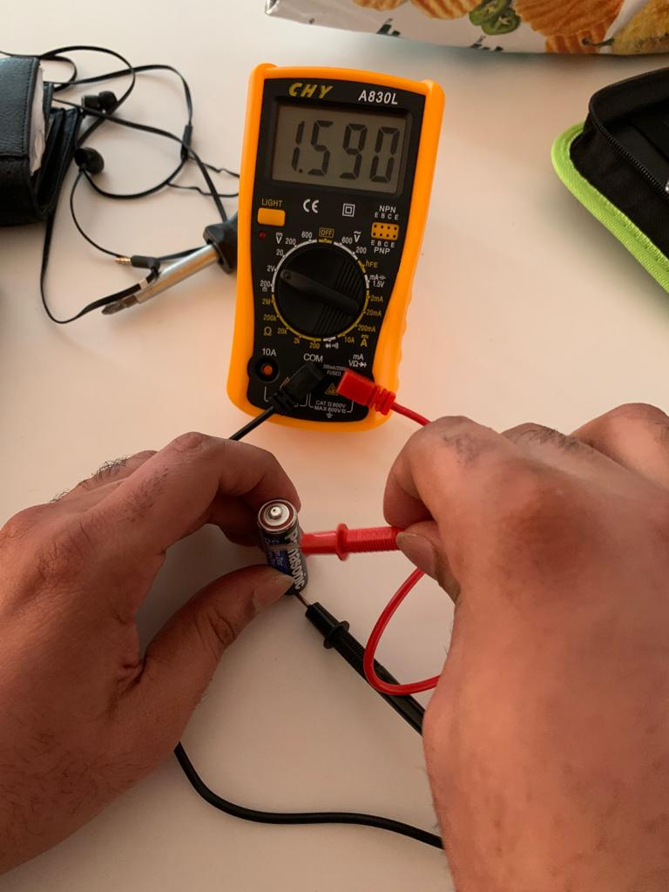
continued

Slide 38
Testing of dht11 sensor module
Testing requirements
DHT11 sensor module
Jumper wires
Arduino uno
Arduino ide
DHT library

Slide 39
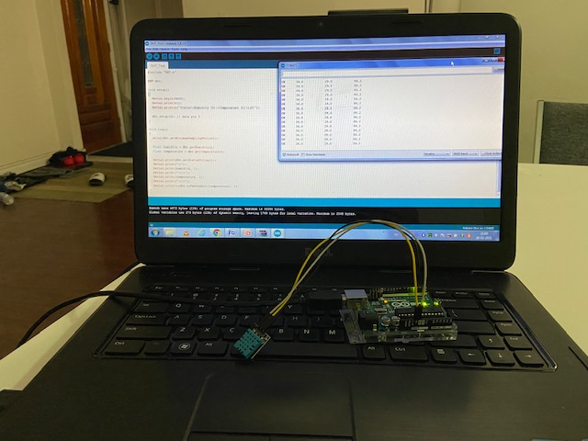
Connections image

Slide 40
Connections
So the sensor here got 3 pins
Vcc ---- 5v of arduino
Ground --- ground of arduino
Data pin – data pin 3 in arduino

Slide 41
continuation
After making succesfull connections downloaded a zip file from the website which has dht library.
Then after adding the library to the arduino ide we are ready to compile the program
After compiling the program one can see the readings in serial monitor

Slide 42
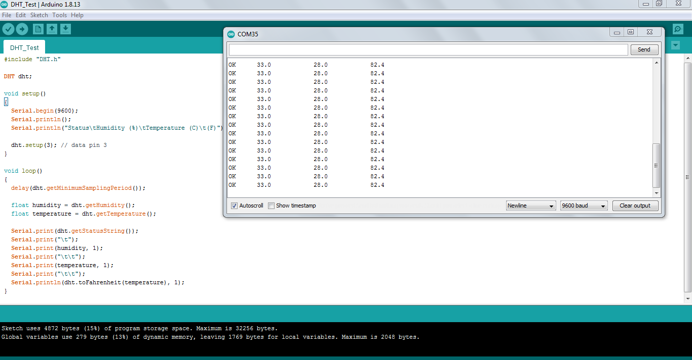
output

Slide 43
Beaglebone black wireless
Testing requirements
Beaglebonebalck wireless
Usb cable
Linux os

Slide 44
Bbb wireless
The beaglebonewireless is a up gradation from beagleboneblack by replacing the 10/100 Ethernet port with onboard 802.11 b/g/n 2.4GHz WiFi and Bluetooth.
For testing the beaglebone wireless used this commands
Ssh debian@192.168.7.2
It will give access as a root user

Slide 45
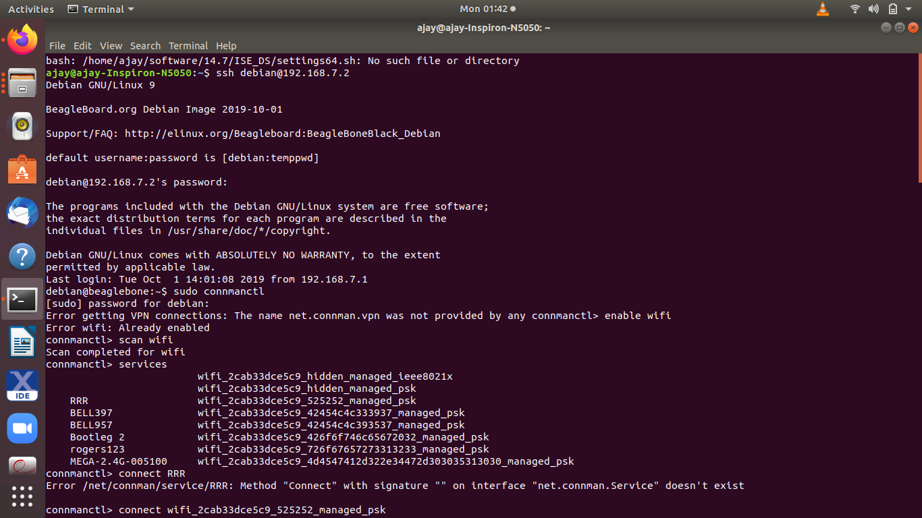
Bbb wireless

Slide 46
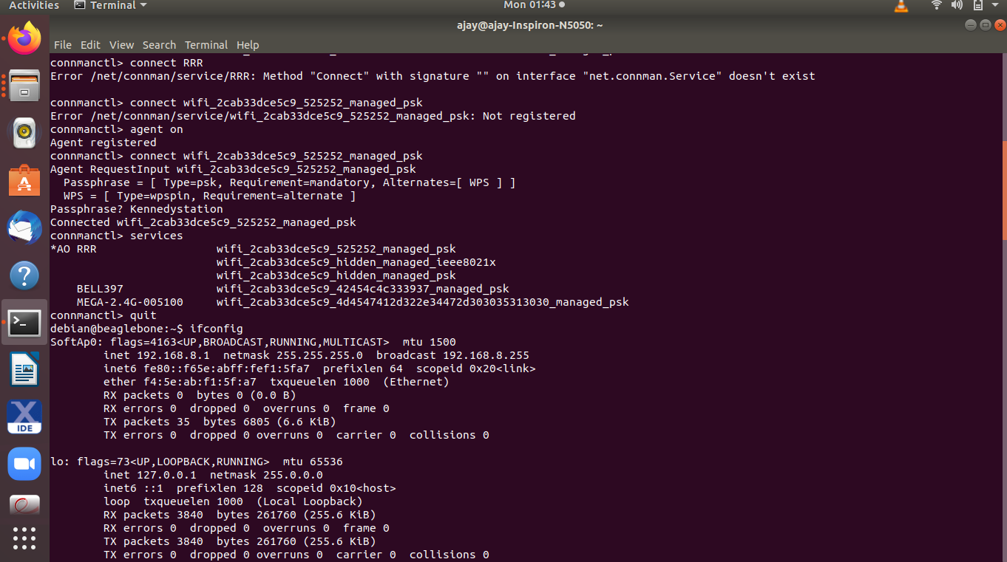
Bbb wireless wifi connection

Slide 47
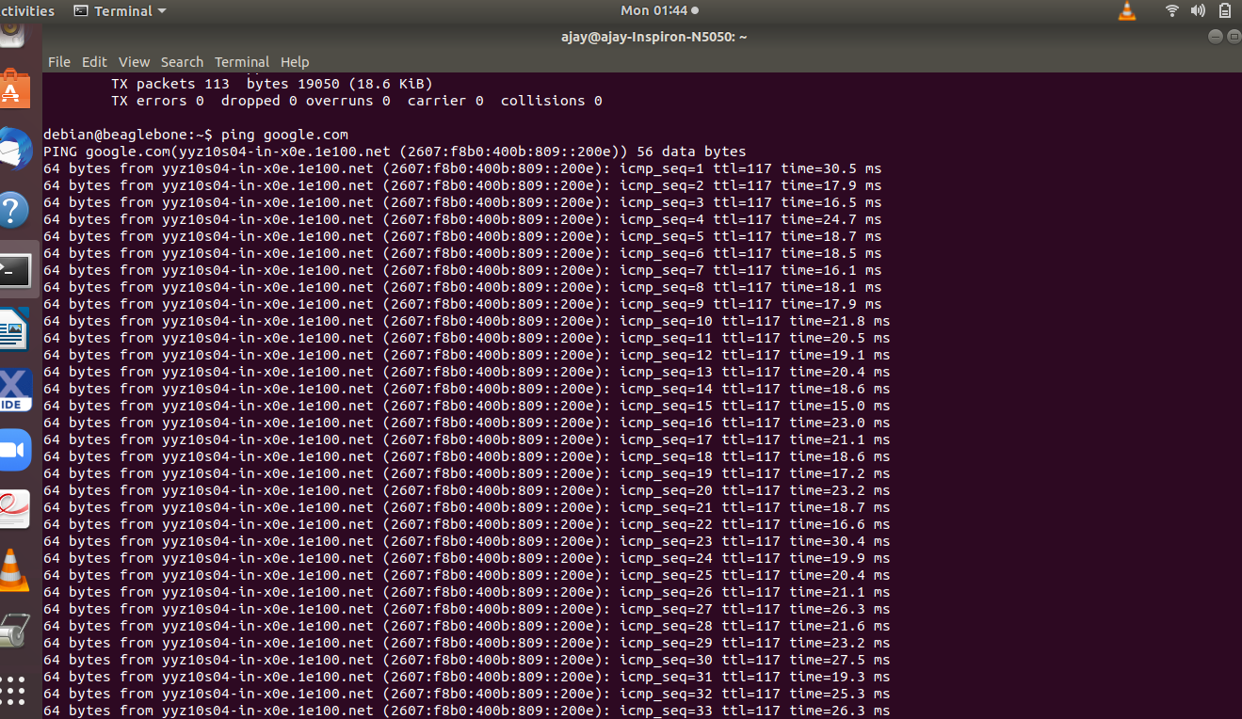
Bbb wireless wifi connection testing

Slide 48
References
For Arduino uno.
https://www.arduino.cc/en/Tutorial/BuiltInExamples/Blink
For rain water sensor module
https://www.instructables.com/Arduino-Modules-Rain-Sensor
For uv index sensor module
https://www.youtube.com/watch?v=vJct0vD6WWg&feature=youtu.be

Slide 49
reference
For 16*2 lcd display
http://www.dsdtech-global.com/2018/05/iic-oled-lcd-u8glib.html
For gsm module
astminuteengineers.com/sim900-gsm-shield-arduino-tutorial/
For digital multimeter
https://youtu.be/TdUK6RPdIrA

Slide 50
References
For dht11
https://www.electronicwings.com/arduino/dht11-sensor-interfacing-with-arduino-uno
For beagleboneblack wireless
https://www.fis.gatech.edu/how-to-configure-bbw-wifi

Slide 51
Thank you

